Slide 1
outside vocabulary
7th grade language arts – Week 7

Slide 2
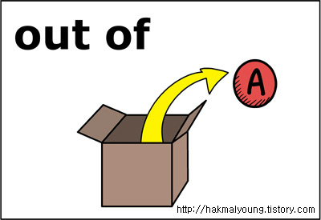
Prefixes
Prefix | Definition | Picture
e- ec- ef- ex- | Out of, outside Ex. emit eclipse effort exit
extra- exter- | Out of, outside, excessive Ex. extraterrestrial exterior

Slide 3
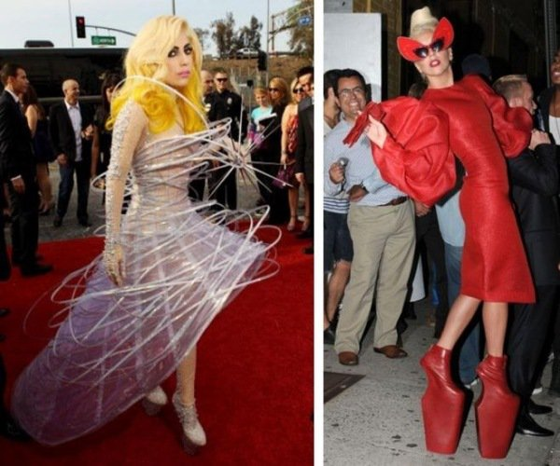
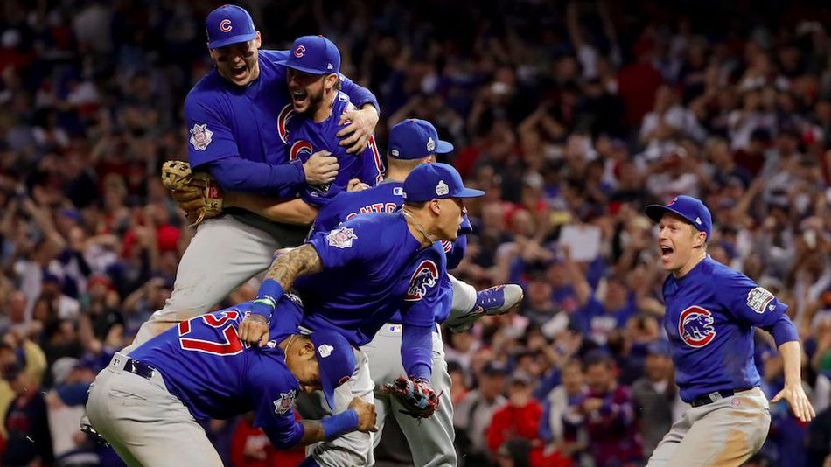
Vocabulary Words
Vocabulary Word | Definition | Picture
eccentric (adjective) | Ignoring social conventions, odd Ex. Lady Gaga’s eccentric style is legendary.
ecstasy (noun) | Happiness, overwhelming feelings of joy Ex. Their ecstasy was obvious after the Cubs players won the World Series and broke the 108 year curse of the goat.

Slide 4
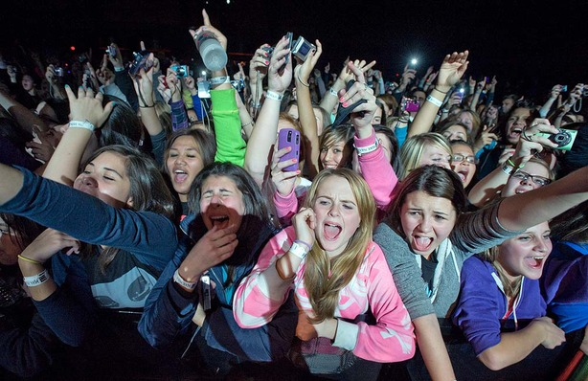
Vocabulary words
Vocabulary Word | Definition | Picture
effervesce (verb) | To give off bubbles; to show excitement or liveliness Ex. Laura Hernandez effervesced while competing as member of the 2016 Olympic Gold Medal Gymnastics Team.
effusive (adjective) | Demonstrative; unreserved; overflowing; pouring out Ex. Justin Bieber’s effusive fans were screaming for him at his concert.

Slide 5
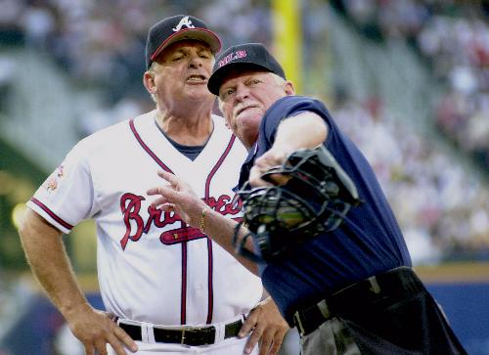
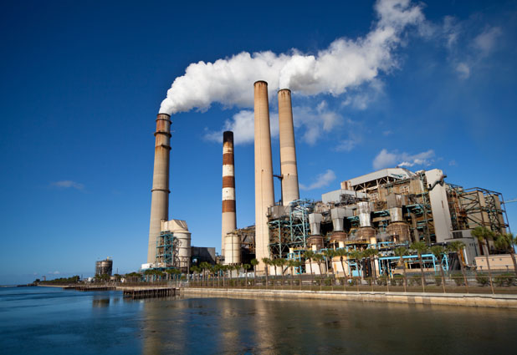
Vocabulary words
Vocabulary Word | Definition | Picture
eject (verb) | Throw out Ex. The umpire ejected the Brave’s manager from the baseball game.
emit (verb) | To send out, discharge Ex. The factory’s smoke stacks emit chemicals into the air.

Slide 6
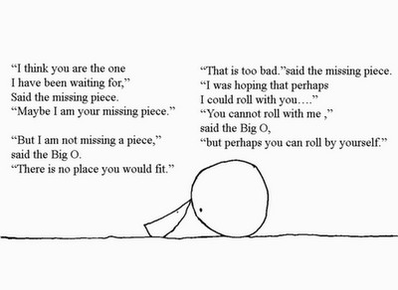
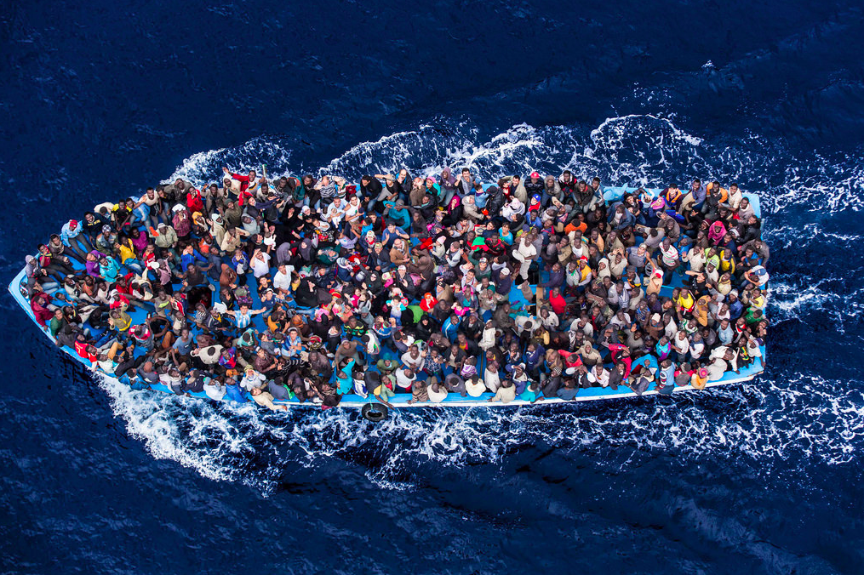
Vocabulary words
Vocabulary Word | Definition | Picture
excerpt (noun) | A selected passage from a book or article Ex. This is excerpt from the Shel Silverstein’s The Missing Piece Meets the Big O.
exodus (noun) | A departure or journey away from a place Ex. The Syrian refugees started on an exodus across the ocean away from their war-torn country.

Slide 7
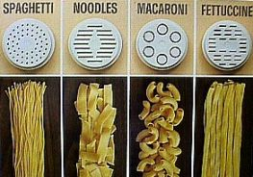
Vocabulary words
Vocabulary Word | Definition | Picture
expulsion (noun) | A forcing out Ex. The sign warns that expulsion from school can be the consequence for bullying, harassment, and violence in school.
extrude (verb) | Force or press out Ex. Many types of pasta are made by extruding the pasta dough through a machine.

