Slide 1
Coming through vocabulary
7th grade language arts – Week 6

Slide 2
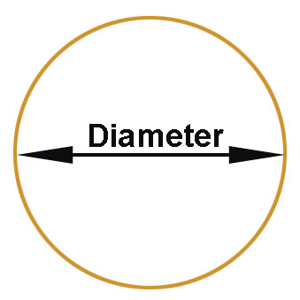
Prefixes
Prefix | Definition | Picture
dia- | through, across Ex. diameter
per- | through, across Ex. perceive

Slide 3
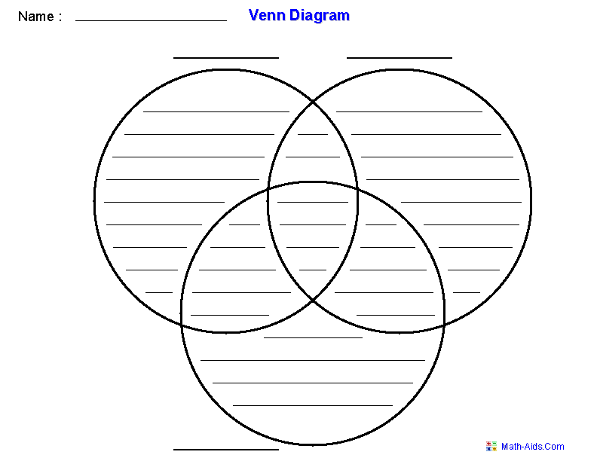
Vocabulary Words
Vocabulary Word | Definition | Picture
diagram (noun) | A picture drawn to explain an idea
diagnose (adjective) | To identify a disease through symptoms

Slide 4
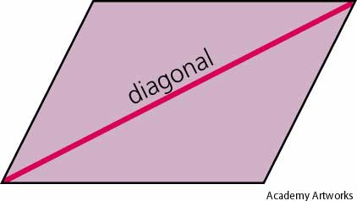
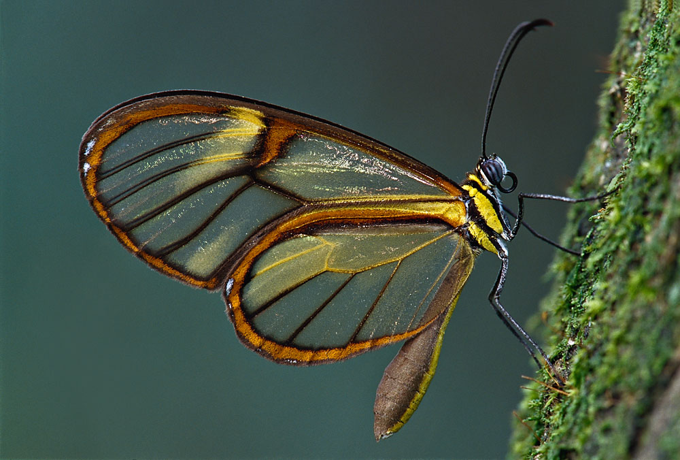
Vocabulary words
Vocabulary Word | Definition | Picture
diagonal (noun) | A straight line through a figure from one corner to another corner
diaphanous (adjective) | Transparent, capable of being seen through

Slide 5
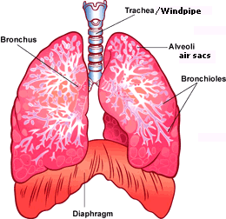
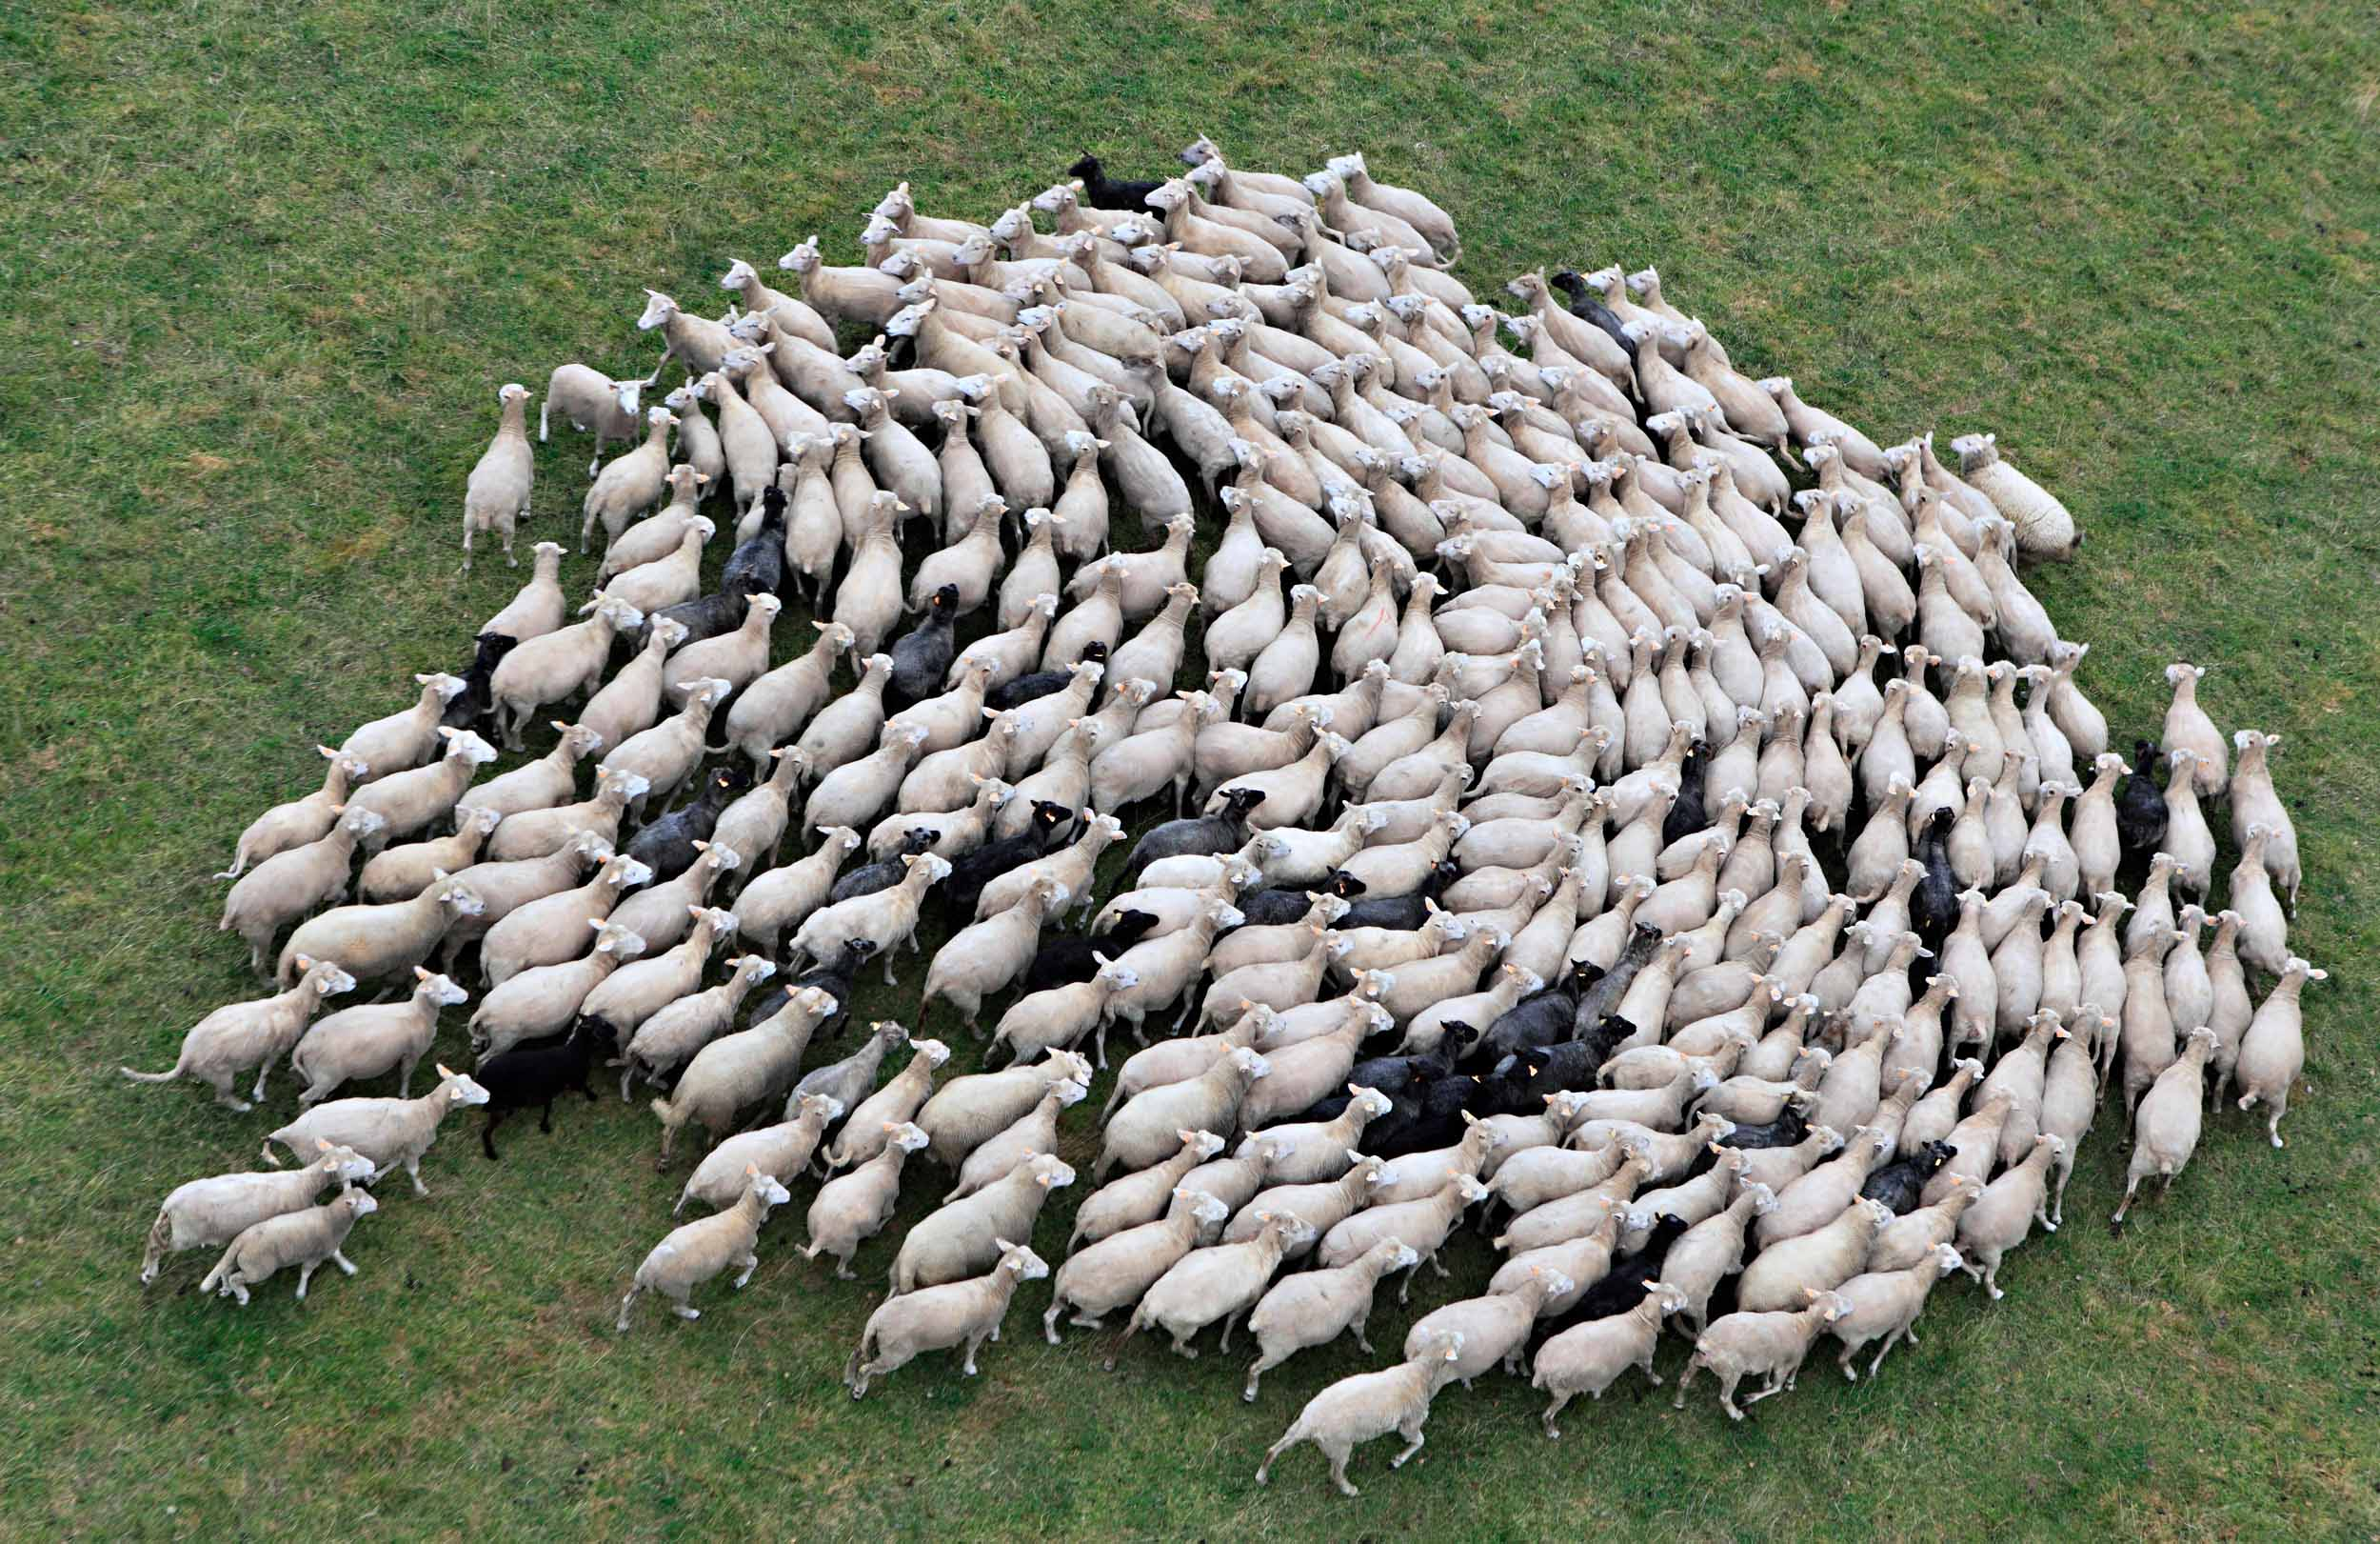
Vocabulary words
Vocabulary Word | Definition | Picture
diaphragm (noun) | A membrane that separates one thing from another, such as the chest cavity and the abdominal cavity
perambulate (verb) | To walk through, over or around

Slide 6
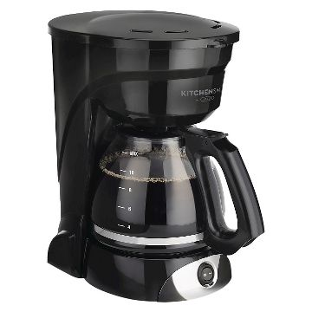
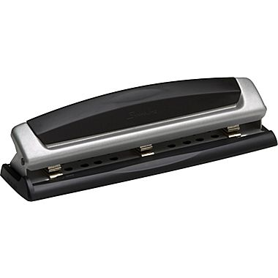
Vocabulary words
Vocabulary Word | Definition | Picture
percolate (verb) | To drip through a small opening or to filter a liquid
perforate (verb) | To make holes in something

Slide 7
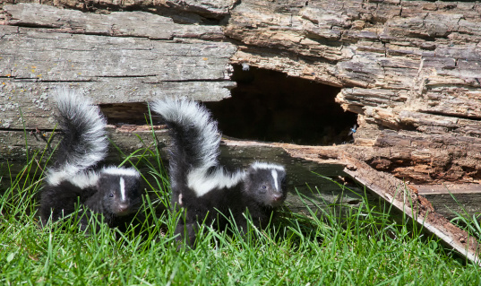
Vocabulary words
Vocabulary Word | Definition | Picture
persistence (noun) | Continuing stubbornly without giving up; determination
pervasive (adjective) | Having the power to be spread or to pass through

