Slide 1
Backward and Forward vocabulary
7th grade language arts – Week 4

Slide 2
Prefixes
Prefix | Definition | Picture
Pro- | Forward, before Ex. proceed
Retro- | backwards Ex. retro

Slide 3
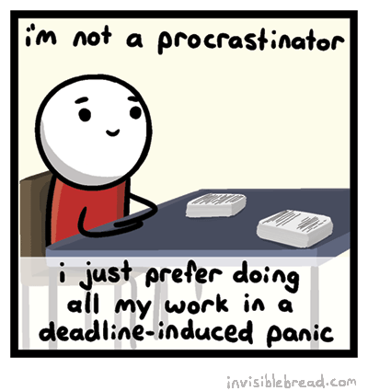
Vocabulary Words
Vocabulary Word | Definition | Picture
procrastinate (verb) | To put off doing something until a later time
profess (verb) | To come forward and make a public declaration

Slide 4
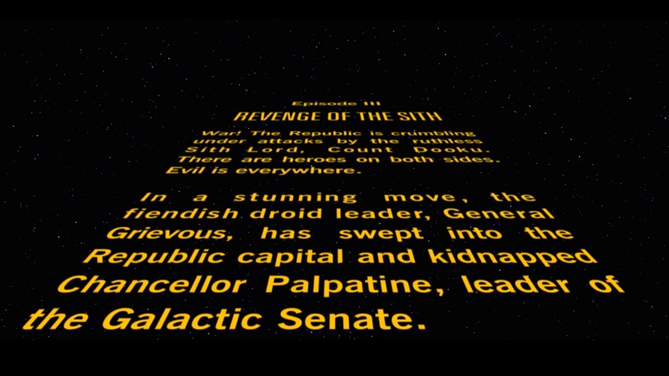
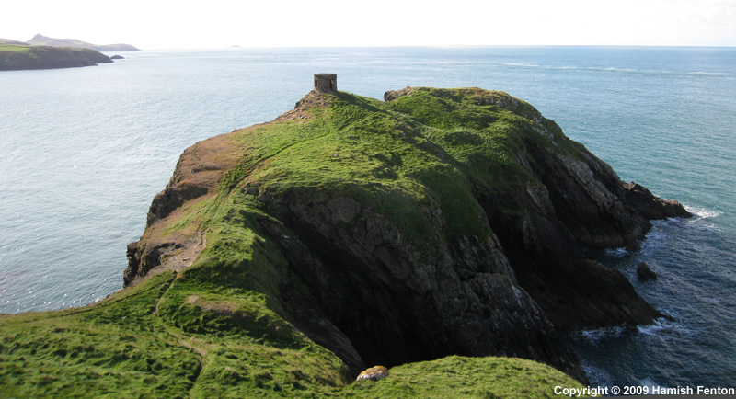
Vocabulary words
Vocabulary Word | Definition | Picture
Prologue (noun) | The introductory part of a book, play, or poem
promontory (noun) | The highest point of land projecting out over a body of water or land

Slide 5
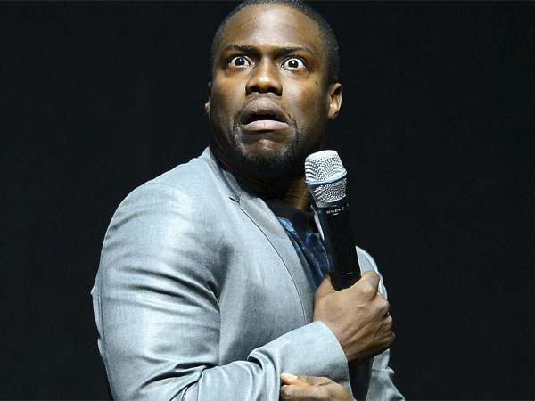
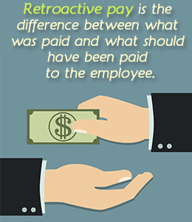
Vocabulary words
Vocabulary Word | Definition | Picture
propensity (noun) | A natural inclination toward
retroactive (adjective) | Having an effect on things in the past

Slide 6
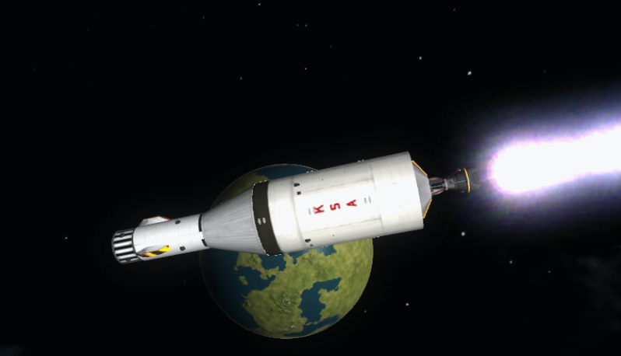
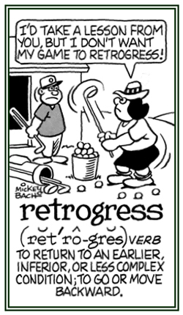
Vocabulary words
Vocabulary Word | Definition | Picture
Retrofire (verb) | To ignite a retrorocket
retrogress (verb) | Move backward, especially to an earlier or worse state

Slide 7
Vocabulary words
Vocabulary Word | Definition | Picture
retrospect (noun) | Looking back on the past
retrospective (adjective) | Looking back on the past or past events

